Slide 1
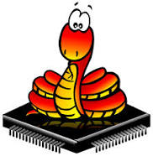

A quick introduction to MicroPython
MicroPython
https://micropython.org
Wouter van Ooijen
wouter.vanooijen@cboost.nl

Slide 2

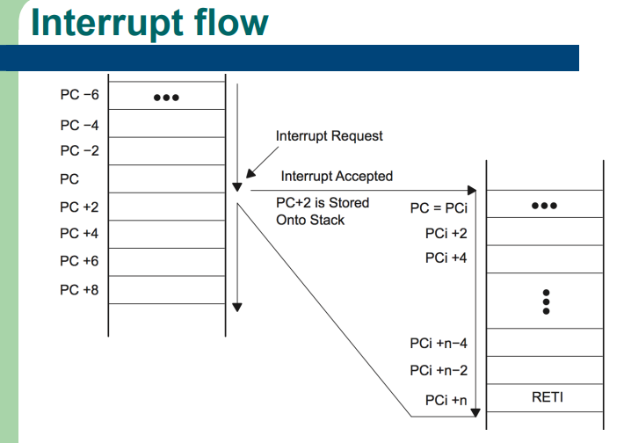
Questions are welcome

Slide 3
Me
TU Delft Informatica 1988
ICT Automatisering
VAX11 industrial datacommunication
@ Fokker Space / Dutch Space: Era Robotic ARM
@ Hollandse Signaal / Thales: SmartNet ATM comms system
VOTI webshop, self-employed (NLR), projects
Hogeschool Utrecht: lecturer Technische Informatica
C, C++, assembler, Python, SE, electronics
Cboost
embedded specialist
Wouter van Ooijen
wouter.vanooijen@cboost.nl
Programmer by profession, electronics tinkerer by passion

Slide 4
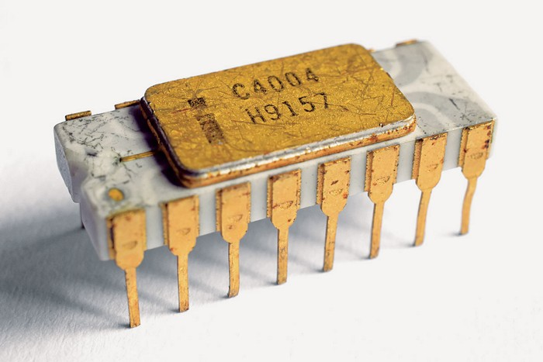
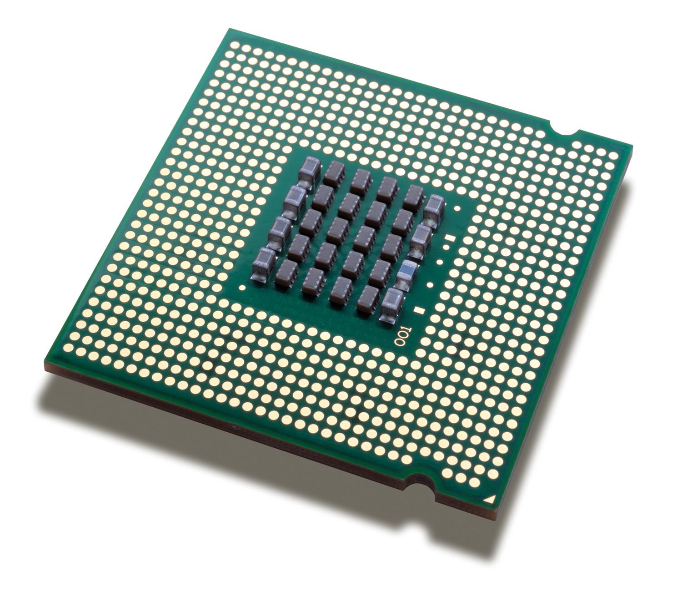
Micro-processor
1971
0.1 MIPS
4 bits
A micro-processor is:
CPU only
What is in your desktop, laptop, server, mobile
$$$
Optimized for processing power
Uses external ROM, RAM, peripherals, ...
Needs LOTS of power (and often cooling)
faster
2023
300 GIPS
64 bits

Slide 5
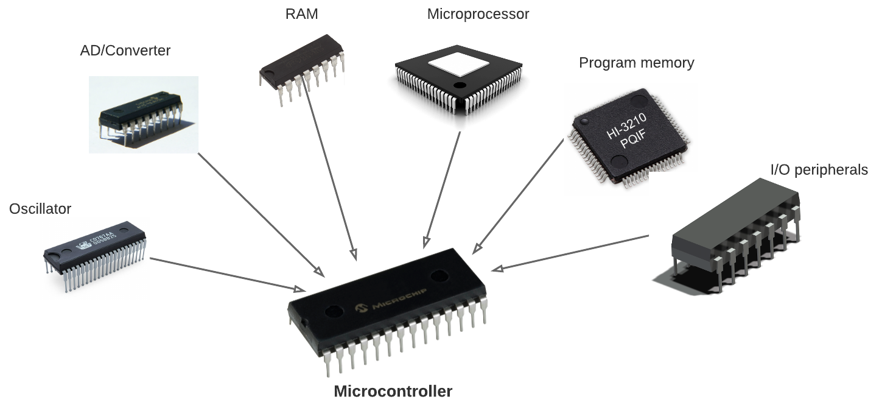
Micro-controller
1971
just the CPU
A micro-controller is
A single* chip with CPU, RAM, FLASH, I/O, …
Cheap, small, low-power
Used for embedded, real-time
(Much) less resources than a desktop
What you find in almost everything that is not a computer
Include more
(OK, a bit faster too)
2023
CPU, MMU
ROM, RAM
GPIO, A/D, D/A
I2C, SPI, I2S
….
If you can actually buy one….
* Next slide

Slide 6
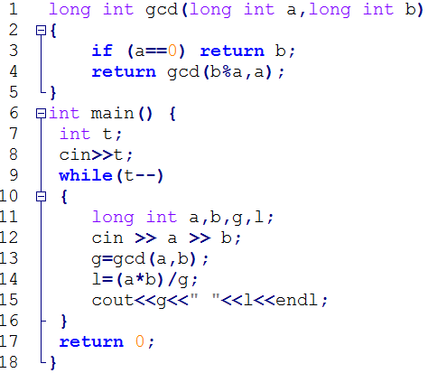


Interpreter
Interprets
Runs
Source code
Interpreter
CPU
interaction

Slide 7
Compiler
Translates
Runs
Source code
Compiler
Runs
CPU
interaction
Application

Slide 8
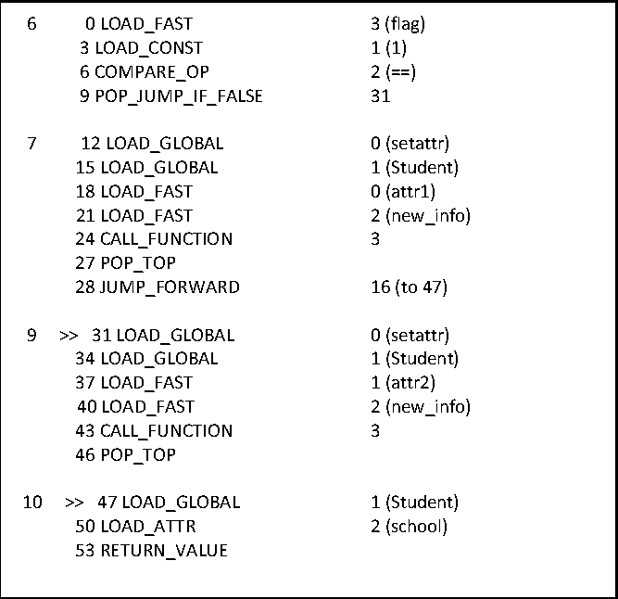
Compiler / Interpreter
Compiler
Translates
Runs
Source code
Runs
CPU
Interprets
interaction
Intermediate code
Interpreter / Virtual Machine

Slide 9
Compiler ⬅➔ Interpreter
Compiler translates (and validates)
Processor or interpreter executes the result of the translation
High-performance languages (typically) compile to CPU instructions (‘run native’)
Python (typically) compiles to Python byte-code
Which is then interpreted by the Python byte-code interpreter

Slide 10

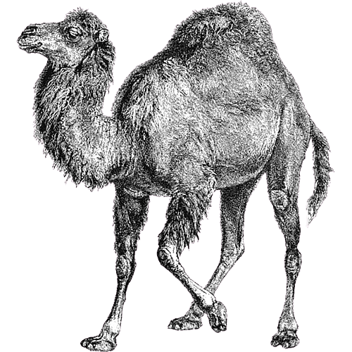



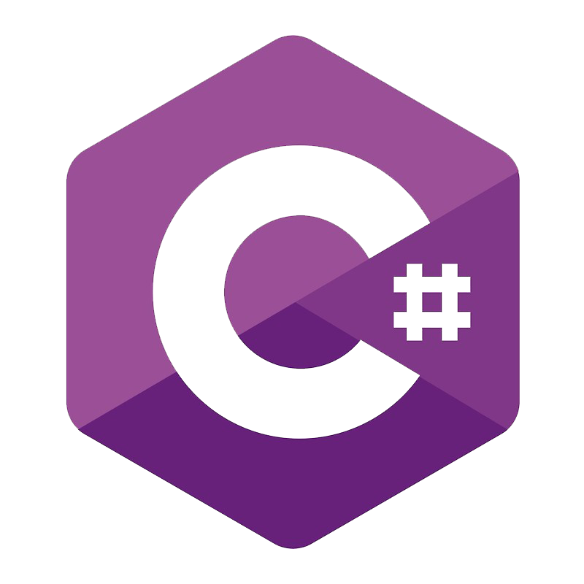


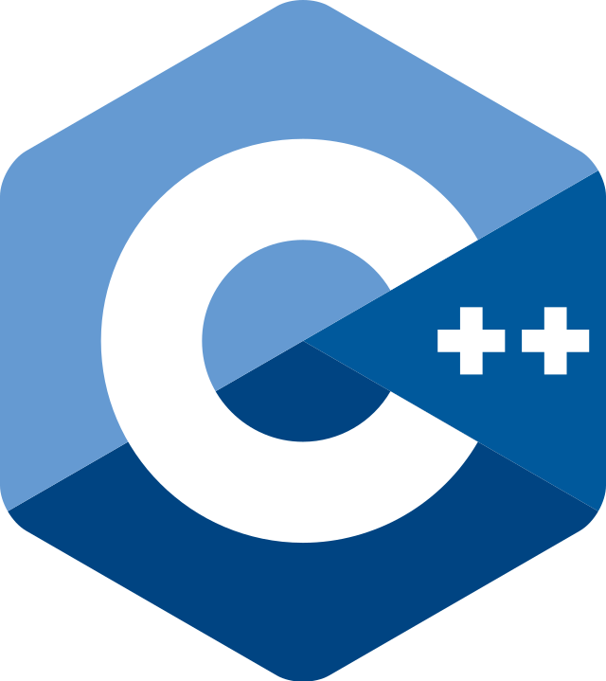




Python’s place
Run-time typed, memory managed ‘scripting’ languages:
Make it easy to do things that ought to be simple.
The programming language for the rest of the population.
Programming for non-programmers.
Get results quickly.*
(at the cost of run-time performance)
Not ideal for larger applications.
High-performance languages:
Get the best run-time performance
Optimize for large, complex applications.
(at the cost of programmer education, coding/debugging time)
Not ideal for explorative work.

Slide 11

3 broad groups of languages
Writes faster, easier on small programs
Typing | Run-time |  |  | Compile-time
Compiles to | Intermediate (interpreter) |  |  | Native (CPU)
Memory Management | Automatic (run-time) |  |  | Manually (programmer)
Runs faster, easier on large programs

Slide 12

(C)Python
Source code
CPU

Slide 13

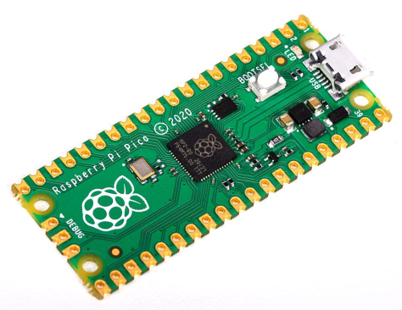
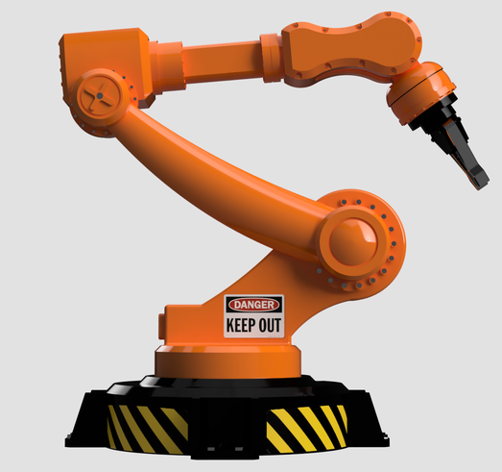
MicroPython
Thonny
Desktop CPU
On the PC
REPL
On the MC
MicroController
MicroPython

Slide 14
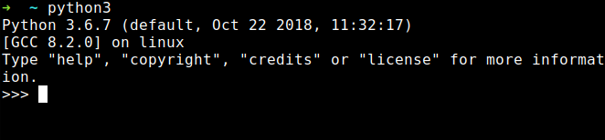
(Micro)Python REPL
Read-Evaluate-Print Loop:
Connects to your PC via serial-over-USB*
Read your input
Evaluate (run) it
Print the result
Repeat this forever
Acts as a primitive Operating System command interpreter
Provides a simple file system
Can interrupt a running program

Slide 15
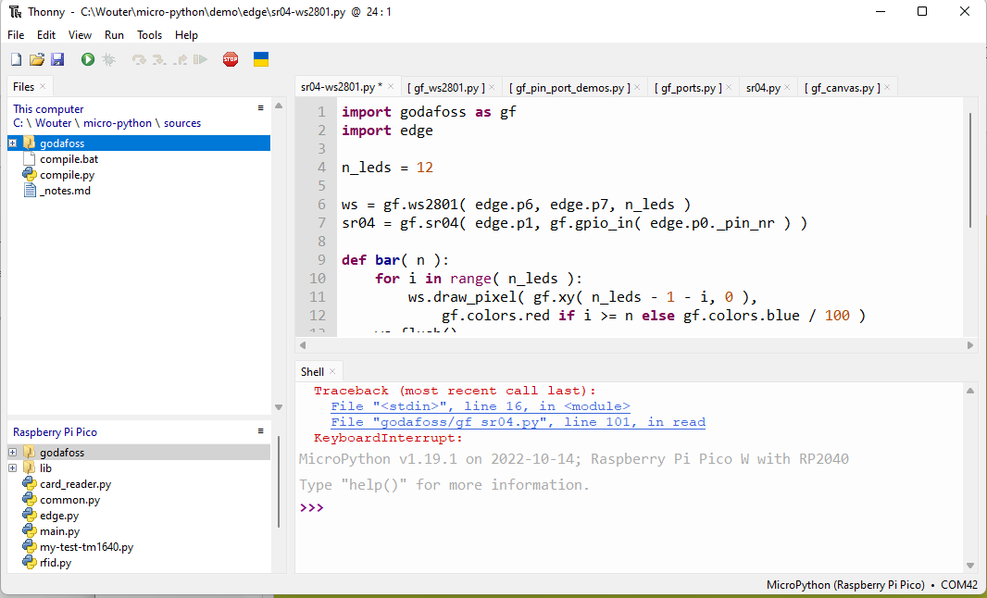
Thonny
Simple Python edit-run IDE
Can be configured to run remotely via REPL over (USB-) serial
Has very simple but useable file system views, with upload / download *
Can directly install MicroPython on some target chips
Editor is a bit primitive (I prefer Notepad++ for serious editing work)

Slide 16
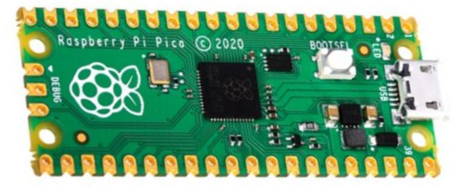
Demo install
Install by hand:
Connect Pi Pico USB while button pressed
RPI-RP (D:) drive shows up in explorer
Copy MicroPython image file to RPI-RP (D:)
Install using Thonny:
Again, Connect Pi Pico USB while button pressed
InThonny: Tools → Options → Interpreter
→ Select MicroPython (Rasberry Pi Pico)
→ Install or update MicroPython, variant H or HW
In thonny:
print ( “Hello” )

Slide 17
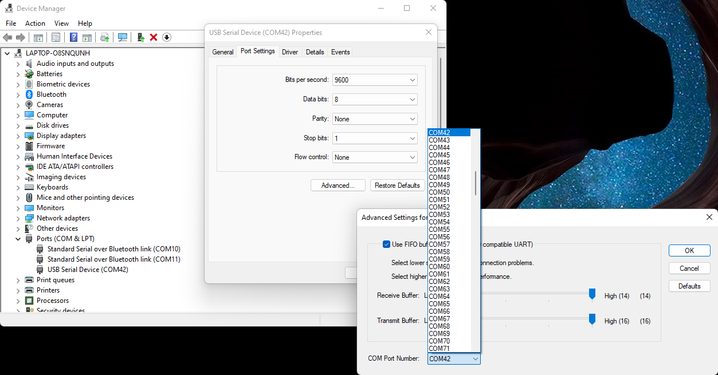
(rename serial port)

Slide 18
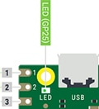
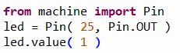
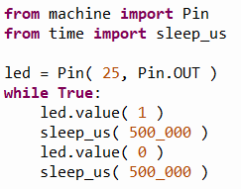
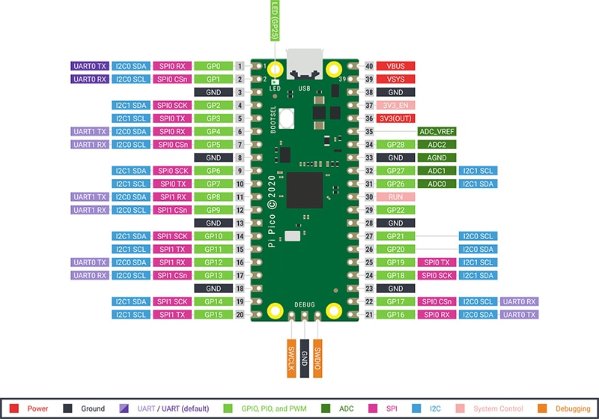
Demo on-board blinky
In Thonny REPL:
In Tonny editor:

Slide 19
Startup
boot.py runs first (at reset or power-up)
REPL STOP is a reset, and re-runs boot.py,
keyboard interrupt doesn’t re-run boot.py
Don’t mess with boot.py unless you really know what you are doing
main.py file runs after boot.py
REPL STOP doesn’t re-run main.py
keyboard interrupt doesn’t re-run main.py either
Put your startup line (import myapp.py) in main.py

Slide 20
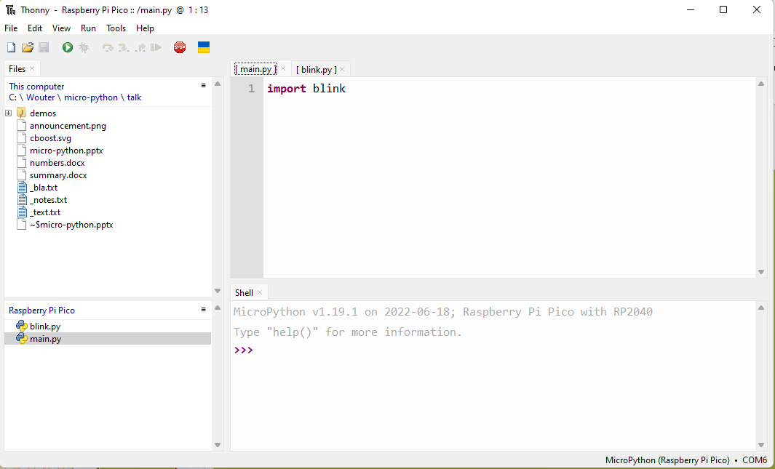
Demo startup
Save blink.py on the target
Create main.py on the target
Connect to power bank

Slide 21
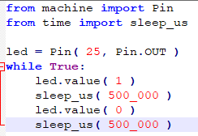
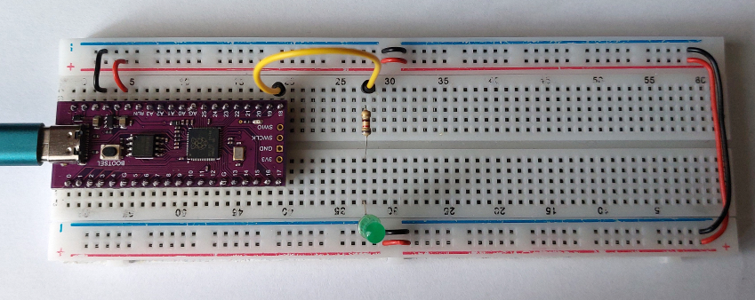
Demo external LED

Slide 22
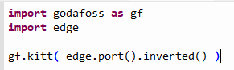
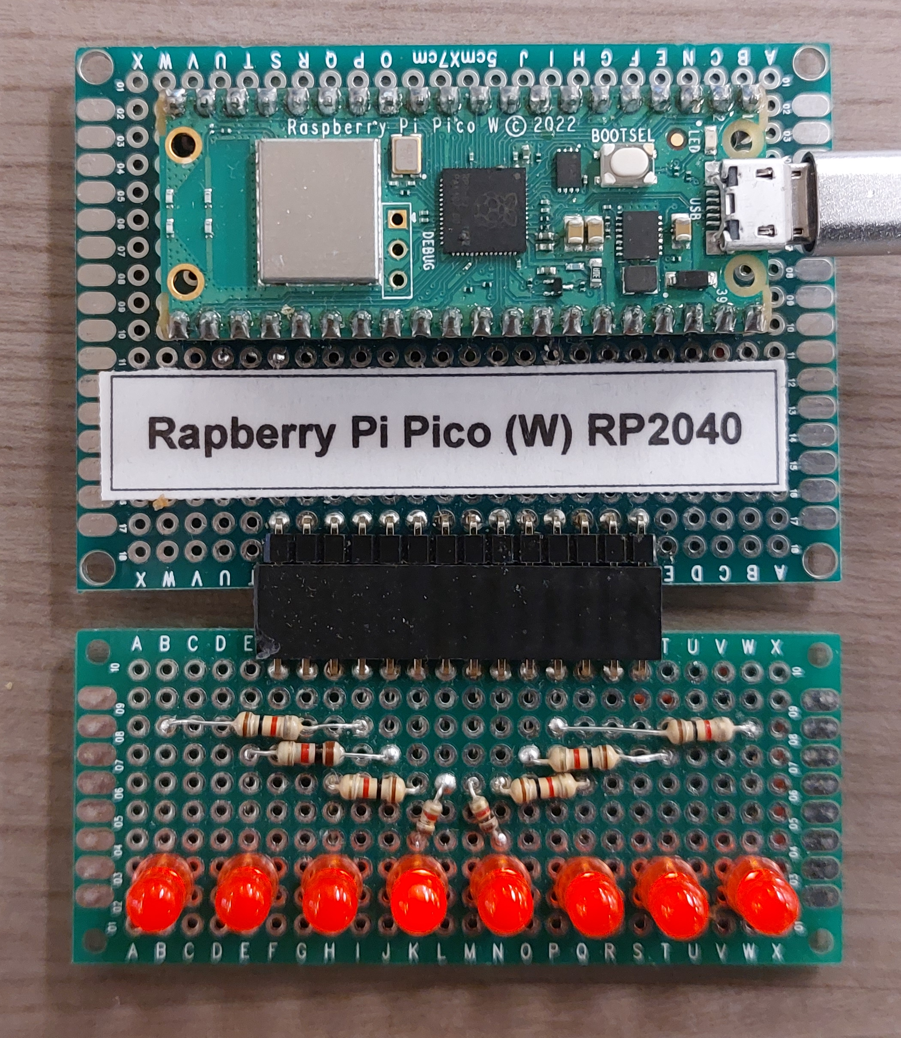
More LEDs!

Slide 23
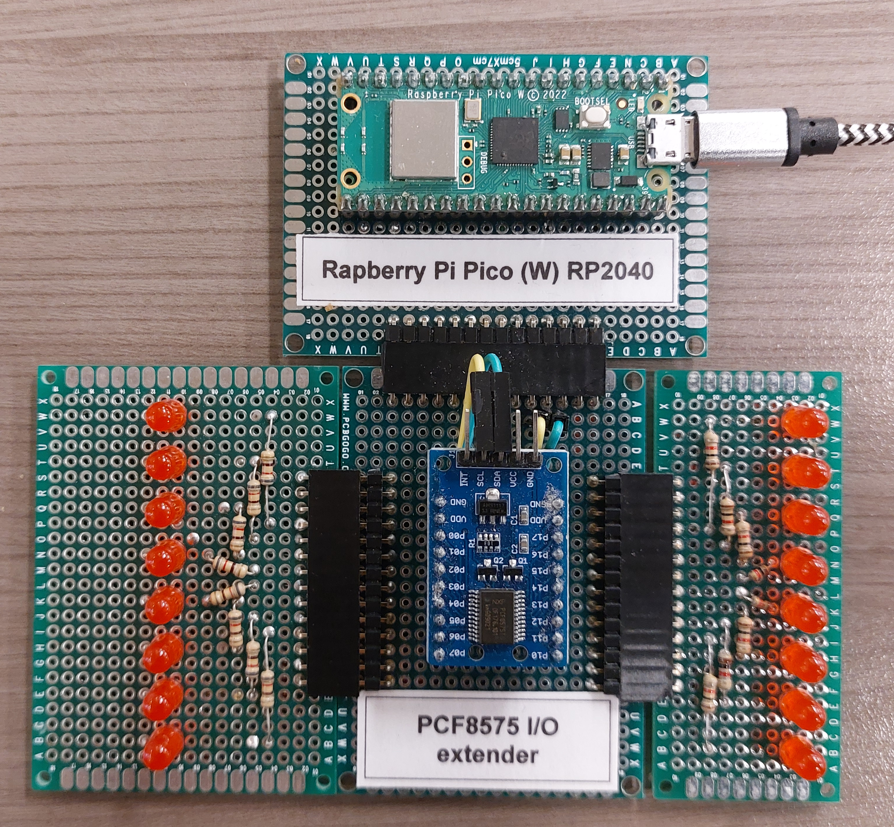
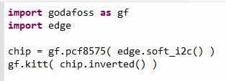
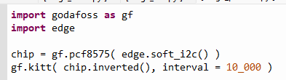
You still want more LEDs?

Slide 24
3 ways
3 ways to work on and use a library
As (.py) sources
As (.mpy) pre-compiled code
As frozen (.mpy) code in the image
Compare using
Pi Pico RP2040 (without W)
MicroPython v1.19.1
Thonny for upload
My feeble laptop for building
My godafosss library code, with on-demand loading (85 files, 471 Kb, heavily commented)

Slide 25
The numbers
Way => Aspect | Sources | Pre-compiled | Frozen
Get it there | 60 s upload | 120 s cross-compile 20 s upload | 40 – 400 s build 20 s install
Loading time | 12 s | 9 s | 1.7 s
RAM footprint | 54 Kb | 54 Kb (126 Kb free) | 31 Kb (154 Kb free)
Edit / run | ++ | - | --
For development, just use a faster / larger target….
Teensy 4.1 | Sources
Loading time | 1 s
RAM footprint | 54 Kb (700 Kb free)

Slide 26
Embedding (freezing) code
FROM ubuntu
RUN apt update
RUN apt install -y build-essential git make python3
RUN apt install -y cmake gcc-arm-none-eabi libnewlib-arm-none-eabi
WORKDIR /work
RUN git clone https://www.github.com/micropython/micropython
WORKDIR /work/micropython
RUN make -C mpy-cross
RUN git submodule update --init -- lib/pico-sdk
RUN git submodule update --init -- lib/tinyusb
WORKDIR /work/micropython/lib/pico-sdk
RUN git submodule update –init
WORKDIR /work/micropython/ports/rp2
RUN make board=PICO submodules
WORKDIR /work/micropython/ports/rp2/modules
COPY modules .
WORKDIR /work/micropython/ports/rp2
RUN make board=PICO)
Download sources + dependencies
Install tooling
Put your files in the correct location
Follow the instructions carefully
Worked for me on Ubuntu, but not on WSL
Use Docker! (demo)

Slide 27
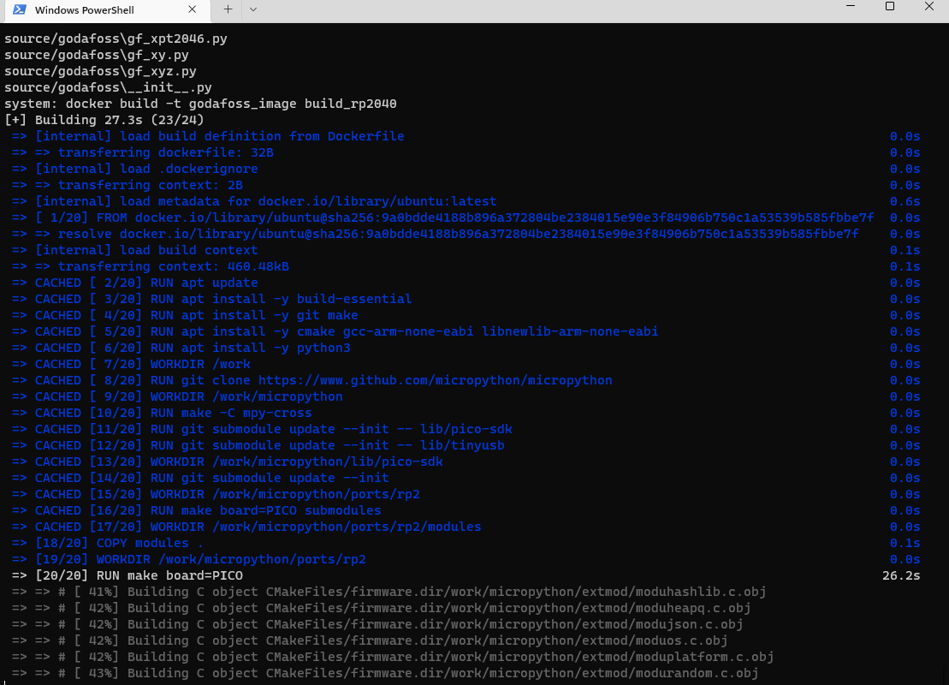
Embedding (freezing) code
Life, if time permits
Takes 40 – 200 s

Slide 28
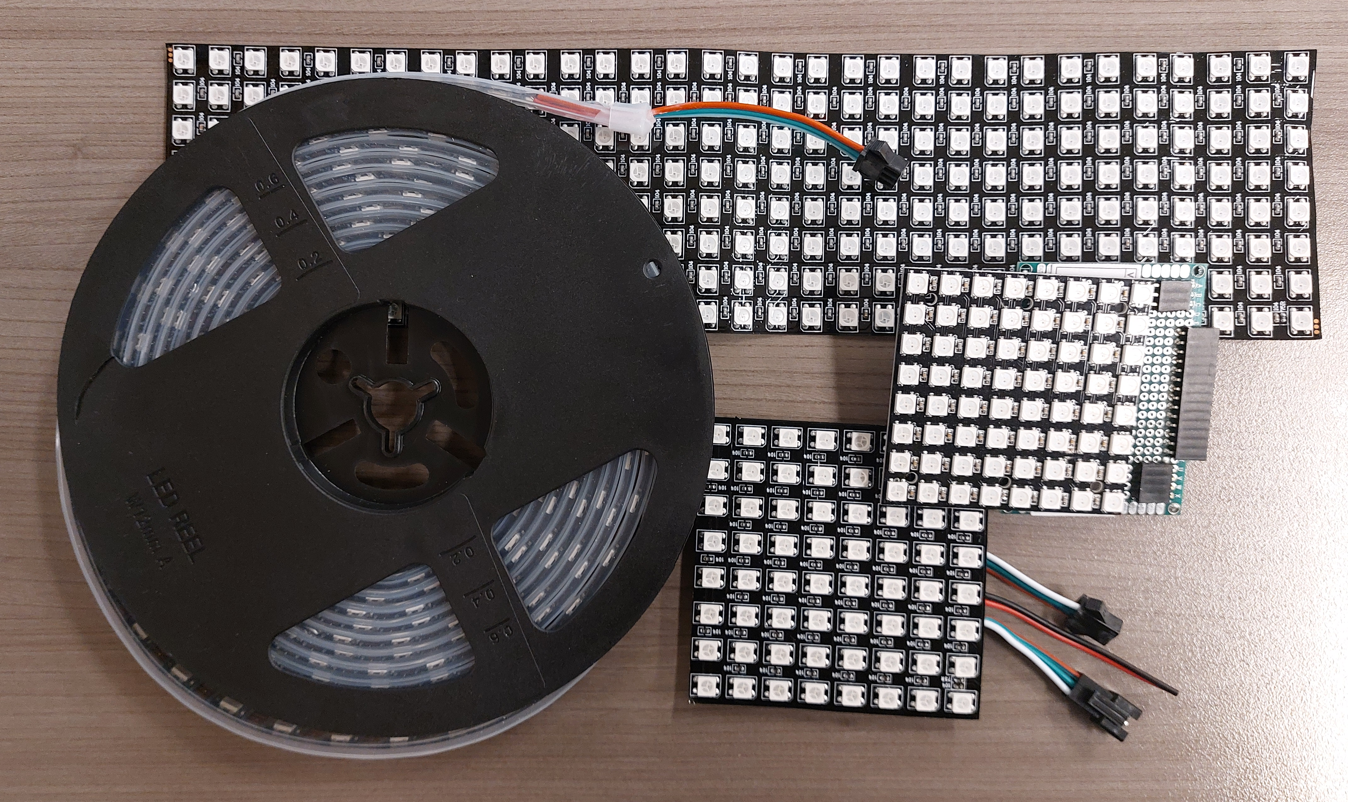
I still want more LEDs
Demo:
Neopixels strip
Neopixels 8 * 8 PCB
Neopixels 8 * 8 flex
Edit source
Neopixels 32 * 8 flex
Neopixels 8 * 8 + 32 * 8

Slide 29
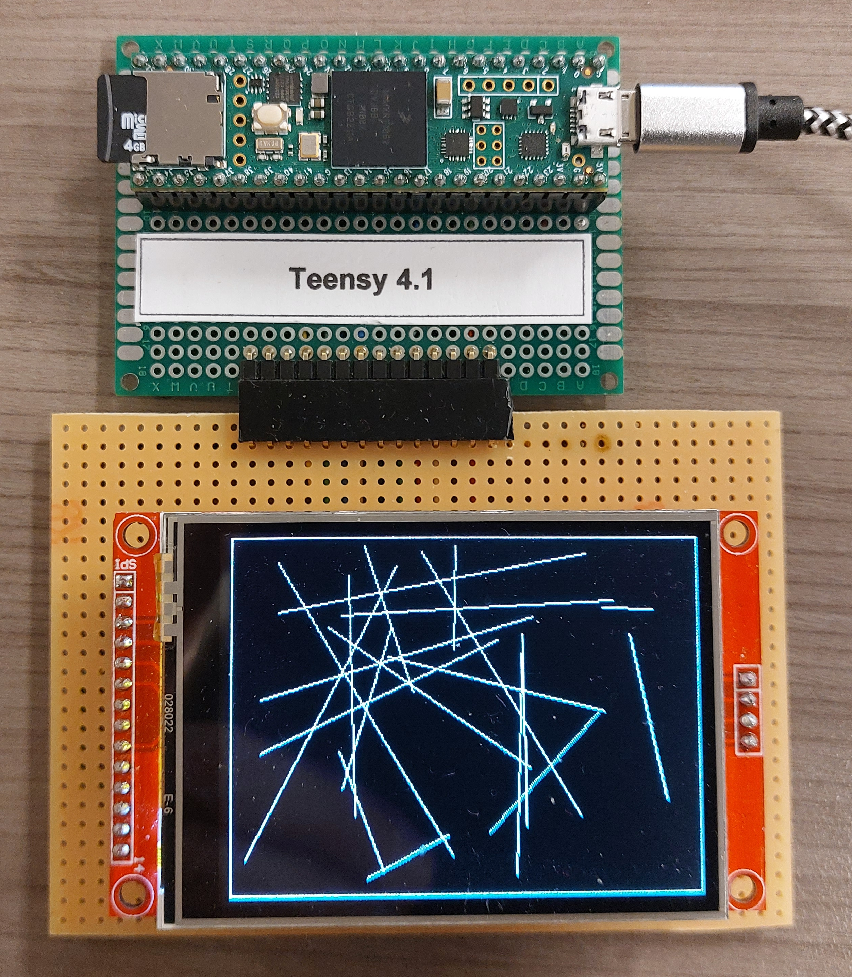
Use a faster chip
DEMO:
Teensy 4.1 screen demo lines etc
Loads very fast!
Teensy 4.1 photos: error, update
Correct, reload

Slide 30
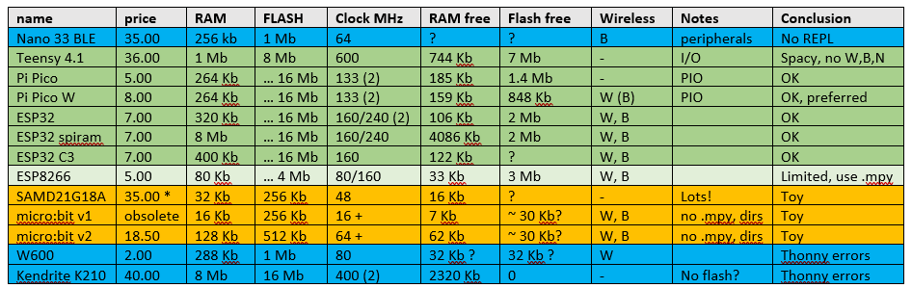
Some target chips/boards

Slide 31
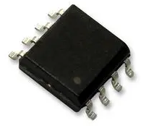
Hybrids
Micro-processor
Micro-something
Micro-controller
CPU
CPU
CPU
RAM
RAM
RAM
RAM
ROM
ROM
ROM
ROM
PERIPHERALS
PERIPHERALS
PERIPHERALS
ESP8266, ESP32, RP2040

Slide 32

RAM
RAM is scarce, the Python is hungry
Split into smaller files to avoid peak RAM use
Use demand-loading (code)
Use pre-compiled files (mpy-cross)
Incorporate (pre-compiled) library files into the MicroPython image (demo)
Use a big fat fast target chip for development

Slide 33
On-demand loading
from submodule import classname
def classname( *args, **kwargs ):
from submodule import classname
return classname(*args, **kwargs )
One trampoline takes ~ 50 bytes
The real code is a bit more complicated

Slide 34
Limitations
Uses a lot of RAM, especially for an LCD graphic buffer
Speed is low (compared to running native code) and can be unpredictable (garbage collection)
Some timing-based HW interface protocols (neopixels, dallas one-wire, DHT11) are not feasible in native Python
Some doubts about running longer time (memory fragmentation), needs occasional 2nd start ☹
Needs more expensive hardware (than a native-code application)
Might use more power (than a native-code application)
Organization is MUCH smaller than python.org (hobbyistic)
Some standard libraries are not available and/or impractical (CPU & memory load)
Not all ports are equal (especially in WiFi details and built-in HW libraries)
No multi-threading (except when multiple CPUs are available)
Type hints not implemented yet

Slide 35
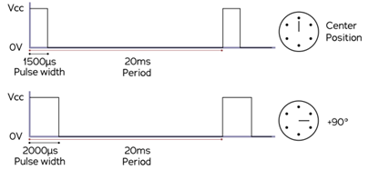
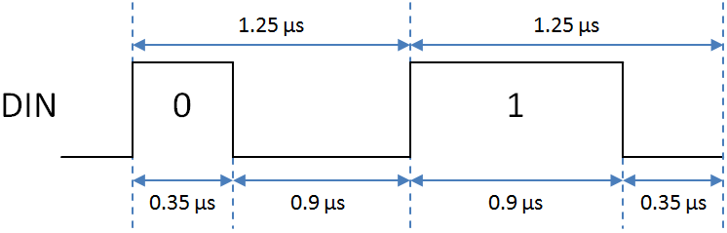
Timing / performance
How much time do you have to do something simple?
1’s of clock cycles: hardware peripherals, assembler, RP2040 PIO’s
10-100’s of clock cycles : C, C++, Rust
1000’s of clock cycles: MicroPython
Servo: 1000 – 2000 µS
Neopixel: 0.35 – 0.9 µS

Slide 36
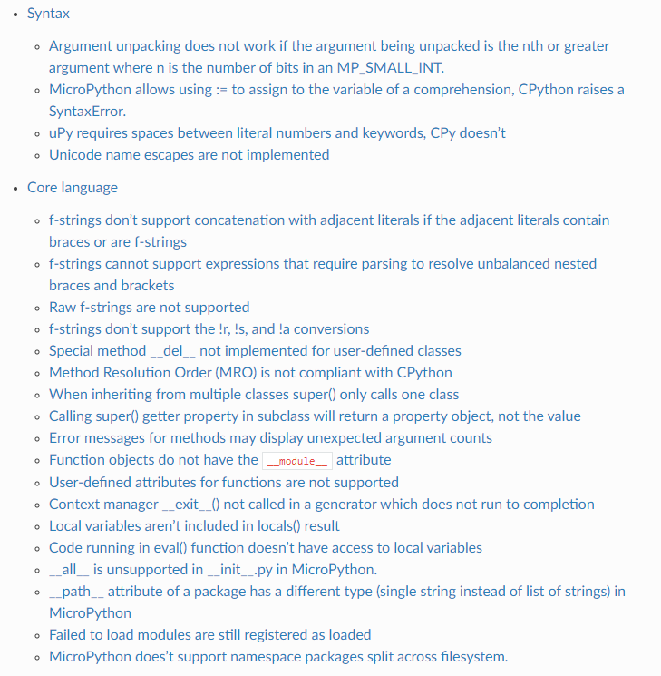
Deviations from CPython
Source: https://docs.micropython.org/en/latest/genrst

Slide 37
Licenses…..
Embedded systems (often) don’t have a console, splash screen, help tab, manual
Are often deeply embedded into something
Licenses that require attribution are a PITA for embedded systems
Prefer a totally free license (C++: boost)
My library: MIT (because it is well-known)
What does that even mean for compiled code??
To be on the safe side….
The above copyright notice and this permission notice shall be included in
all copies or substantial portions of the Software.

Slide 38
Application areas
When faster development outweighs the extra hardware cost:
Tinkering (hobby, education, exploratory work, lab setting)
Prototyping, proof-of-concepts, demos
Testing
Small series
When a somewhat knowledgeable end-user must do some tweaking

Slide 39
Caveats
Where is my code? Be sure to save your work on your PC (too)!
USB can supply only a limited amount of current
Upload, Download
Some chips claim MicroPython support but don’t fully deliver (W600, K210).
An uploaded file is sometimes not recognized as newer? (solution: add a space and upload again)
Thonny sometimes crashes (especially on communication problems – don’t pull the cable!)
Different MicroPython versions and ports can be subtly different (like no neopixels on Teensy)
Want to protect your IP? Probably forget it.

Slide 40
Not covered
Wireless REPL (WiFi)
Embedding native compiled code in the interpreter
Thonny alternatives
CircuitPython: proprietary variation by AdaFruit, very similar but some (irritating) differences
Extending MicroPython by embedding native code in the interpreter (C, C++)
Using MicroPython with RP2040 PIOs
Native code generators (@micropython.native, @micropython.viper)

Slide 41
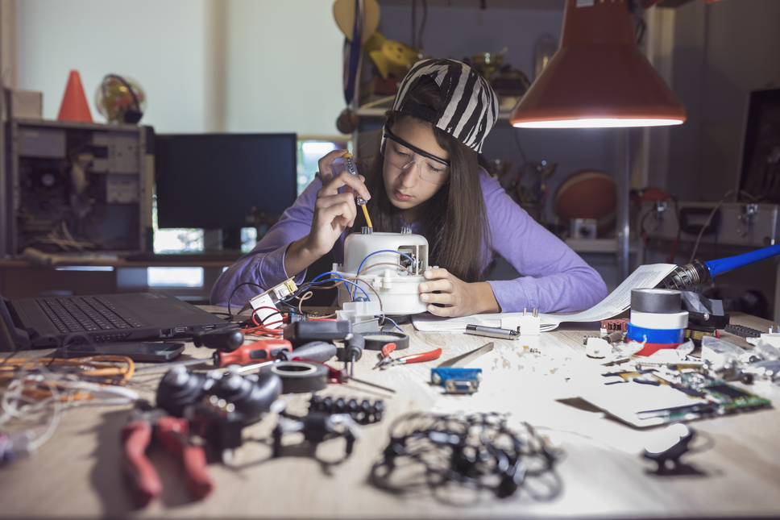
Takeaway?
Get
Arduino peripherals set
Pi RP2040 or ESP32 or Teensy 4.1
Start tinkering!

Slide 42
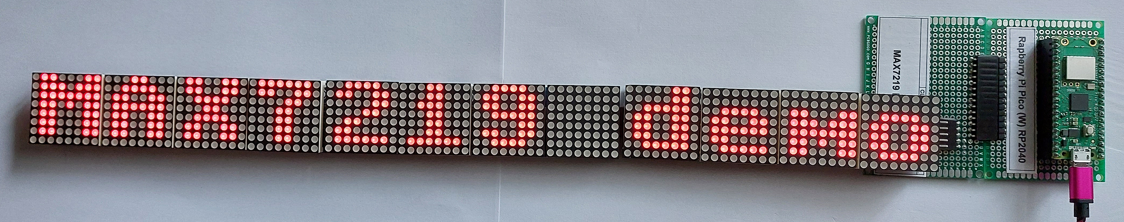
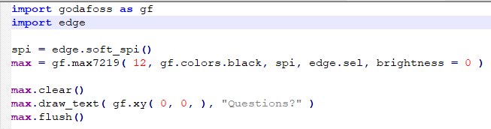
Max7219 demo

